Slide 1
SCSA1304
ADVANCED DATA STRUCTURES
B.E CSE 2019-2023
III SEMESTER

Slide 2
COURSE OBJECTIVES
➢ To acquire knowledge of organizing the data in non
linear fashion.
➢ To get the idea of balancing the height of trees to
optimize the structure and search time.
➢ To learn the process of establishing the network with
various nodes with minimum cost and finding the
shortest path.
➢ To understand the method of designing the table
data structure and its applications.

Slide 3
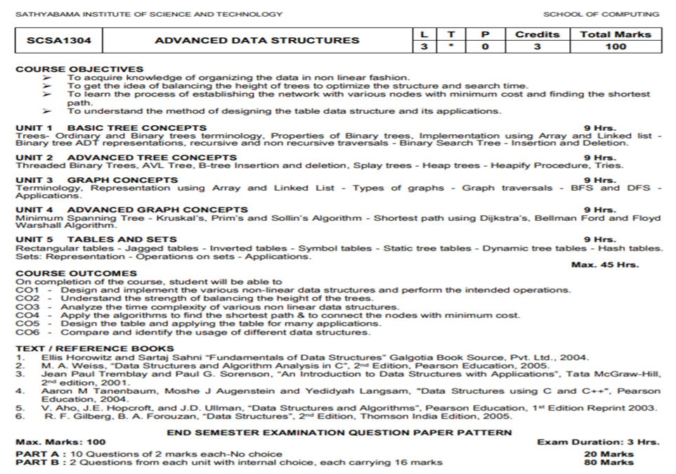

Slide 4
Trees
Non Linear Data structures
Graphs
Sets
Tables

Slide 5
UNIT II – ADVANCED TREE CONCEPTS
Threaded Binary Trees
AVL Tree
B-Tree
Insertion
Deletion
Splay Trees
Heap Trees
Heapify Procedure
Tries

Slide 6
THREADED BINARY TREE
In any binary tree linked list representation, there is a number of NULL pointers than actual pointers. Generally, in any binary tree linked list representation,
if there are 2N number of reference fields,
then N+1 number of reference fields are filled with NULL ( N+1 are NULL, out of 2N).
A.J.Perlis and C. Thornton have proposed new binary tree called "Threaded Binary Tree", which makes use of NULL pointers to improve its traversal process. In a threaded binary tree, NULL pointers are replaced by references of other nodes in the tree. These extra references are called as threads.
A threaded binary tree defined as follows:
"A binary tree is threaded by making all RIGHT CHILD pointers that would normally be null point to the INORDER SUCCESSOR of the node (if it exists), and all LEFT CHILD pointers that would normally be null point to the INORDER PREDECESSOR of the node."
Notes:
A binary tree is represented using array representation or linked list representation. When a binary tree is represented using linked list representation, if any node is not having a child we use NULL pointer in that position. In any binary tree linked list representation, there are more number of NULL pointer than actual pointers.
Generally, in any binary tree linked list representation, if there are 2N number of reference fields, then N+1 number of reference fields are filled with NULL ( N+1 are NULL out of 2N ). This NULL pointer does not play any role except indicating there is no link (no child).

Slide 7
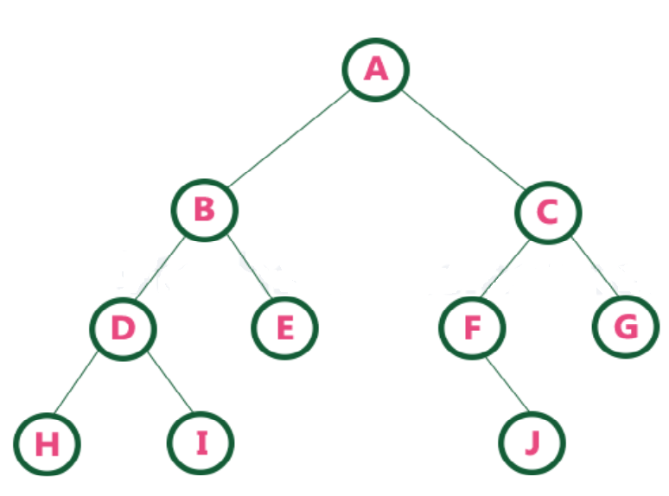
THREADED BINARY TREE
Threaded Binary Tree is also a binary tree (in Linked list representation) in which all
Left child pointers that are NULL points to its In-order Predecessor, and all Right child pointers that are NULL points to its In-order Successor.
If there is no in-order predecessor or in-order successor, then it points to the root node.
In-order traversal of above binary tree:
H - D - I - B - E - A - F - J - C - G

Slide 8
THREADED BINARY TREE
Why do we need Threaded Binary Tree?
To avoid wastage of Memory.
Threaded binary tree makes the tree tra­ver­sal faster since we do not need stack or recur­sion for traversal.
Types of threaded binary trees:
Sin­gle Threaded: Each node is threaded towards either the in-order pre­de­ces­sor or suc­ces­sor (left or right) means
all right null point­ers will point to INORDER SUC­CES­SOR OR
all left null point­ers will point to INORDER PREDECESSOR.
Dou­ble threaded: All right null point­ers will point to inorder suc­ces­sor AND
all left null point­ers will point to inorder predecessor.
Notes:
Disadvantages :
Complex Structure
Insertion and Deletion takes more time
A field that holds the address of its inorder successor or predecessor is known as thread.

Slide 9
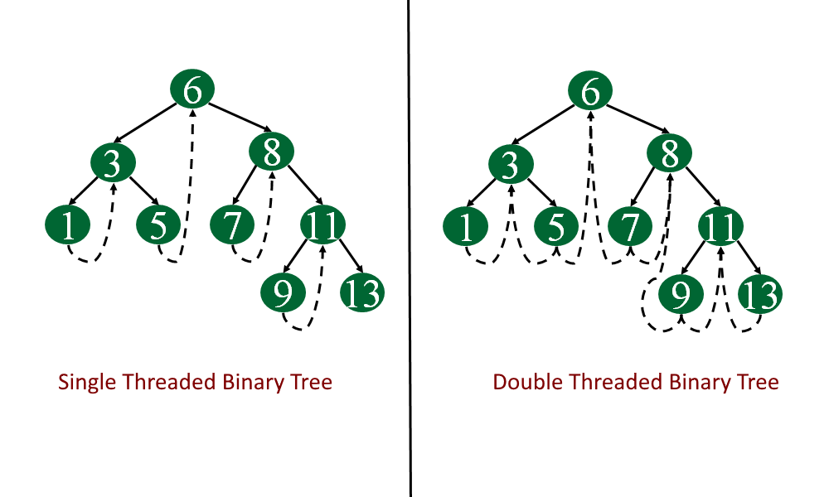
SINGLE (One Way) / DOUBLE (Two Way) THREADED BINARY TREES
The empty left child field of a node can be used to point to its inorder predecessor. Similarly, the empty right child field of a node can be used to point to its in-order successor.
Such a type of binary tree is known as a Single threaded binary tree.
Notes:
In the threaded binary tree when there is only one thread is used then it is called as one way threaded tree and
when both the threads are used then it is called the two way threaded tree. The pointer point to the root node when If there is no in-order predecessor or in-order successor.

Slide 10
THREADED BINARY TREE
Node Structure :
Each node has five fields
LeftThread | Left | Data | Right | RightThread
The Node Structure in C is given as :
struct node
{
int data
struct node *Left, *Right;
bool LeftThread;
bool RightThread;
};

Slide 11
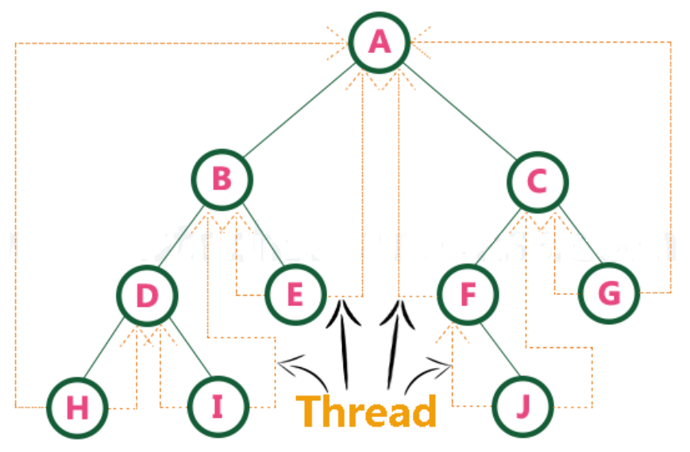
THREADED BINARY TREE

Slide 12
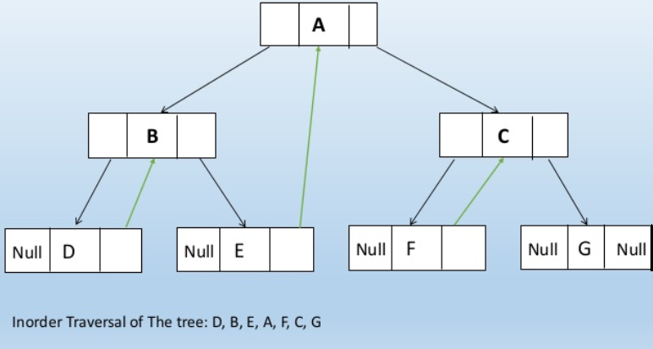
THREADED BINARY TREE

Slide 13
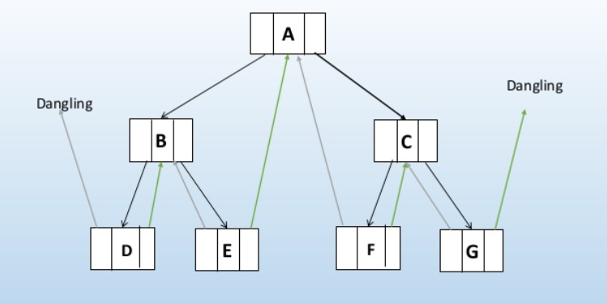
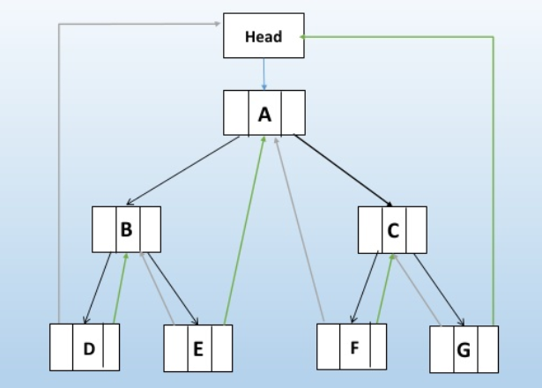

THREADED BINARY TREE

Slide 14
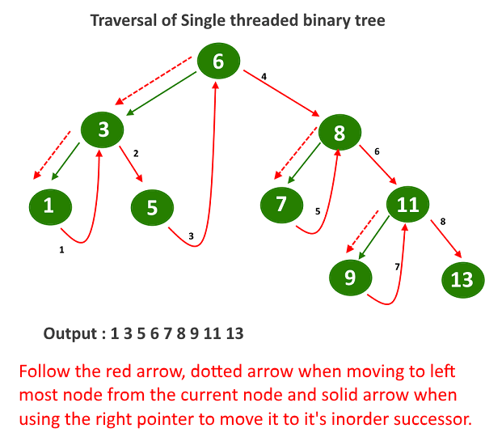
INORDER ORDER TRAVERSAL USING THREADS
Leftmostnode(Node)
T = Node
if T == NULL
return NULL;
endif
while T -> Left != NULL
T = T -> Left
endwhile
return T
Inorder(Root)
Current = Leftmostnode (Root);
while (Current != null)
Write Current -> data
if (current.rightThread) {
Current = Current -> Right
else
Current = Leftmostnode ( Current -> Right)
endif
endwhile
EndInorder()

Slide 15
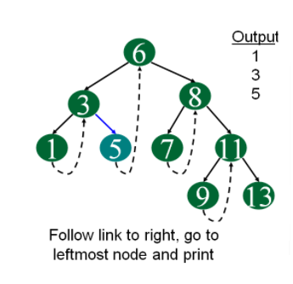
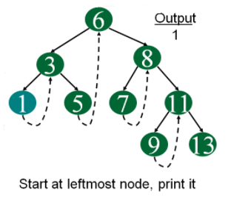
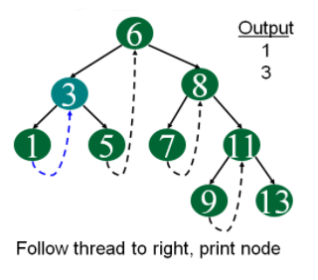
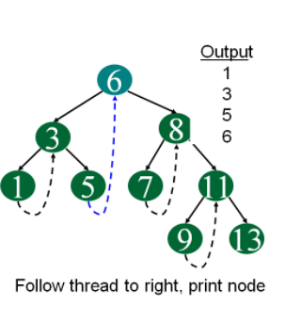
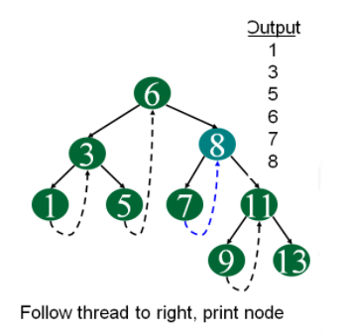
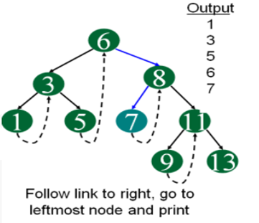
INORDER ORDER TRAVERSAL USING THREADS
Output : 1 3 5 6 7 8 9 11 13

Slide 16
THREADED BINARY TREE
Advantages of Thread Binary Tree
Non-recursive pre-order, in-order and post-order traversal can be implemented without a stack.
Disadvantages of Thread Binary Tree
Insertion and Deletion operation becomes more difficult.
Memory required to store a node increases. Each node has to
store the information whether the links is normal or threaded links.

Slide 17
AVL TREES – HEIGHT BALANCED BST
The Height balanced trees were developed by researchers Adelson-Velskii and Landis E.M in the year 1962. Hence these trees are also called AVL trees. Height balancing attempts to maintain the balance factor of the nodes within limit.
Height of the tree: Height of a tree is the number of nodes visited in traversing a branch that leads to a leaf node at the deepest level of the tree.
Balance factor: The balance factor of a node is defined to be the difference between the height of the node’s left subtree and the height of the node’s right subtree.
In an AVL tree, every node maintains an extra information known as balance factor.
Balance factor = Height of LeftSubtree – Height of RightSubtree

Slide 18
AVL TREES – HEIGHT BALANCED BST
An empty tree is height-balanced.
If T is a non empty binary search tree with T_{L} and T_{R} as
its left and right subtrees respectively, then T is height
balanced if and only if
T_{L} and T_{R} are height balanced
| h_{L} - h_{R} | ≤ 1 where h_{L} and h_{R} are the heights of T_{L} and T_{R} respectively.
i.e. For any node in an AVL Tree the Balance Factor(T) should be either -1 or 0 or 1

Slide 19
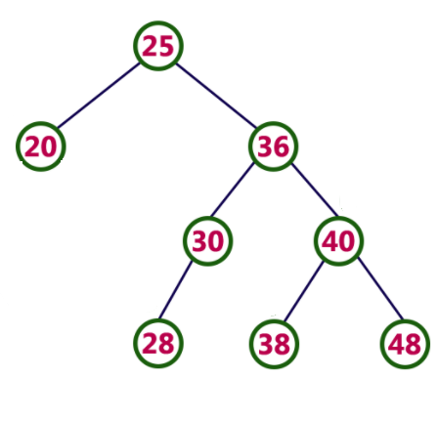
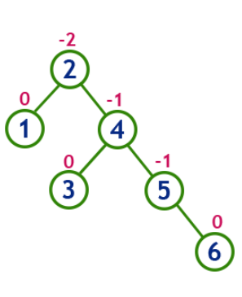
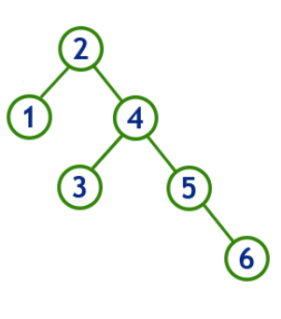
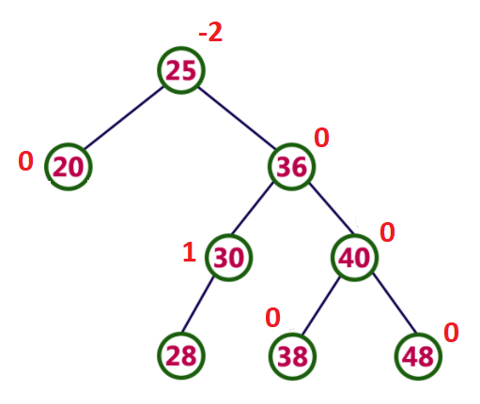
AVL TREES – HEIGHT BALANCED BST
Examples of Unbalanced Trees

Slide 20
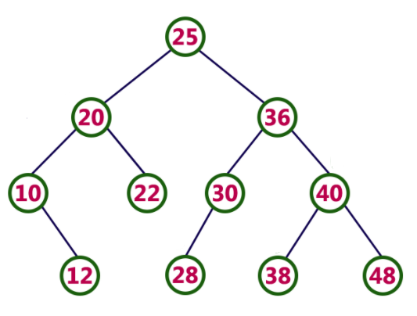
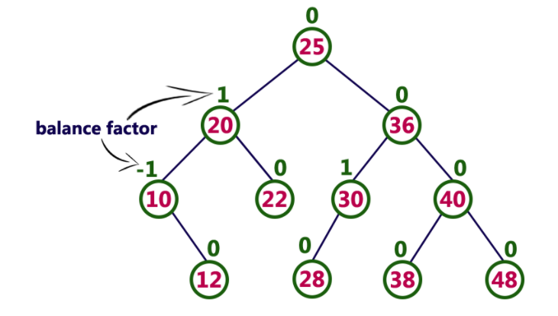
AVL TREES – HEIGHT BALANCED BST

Slide 21
AVL TREE ROTATIONS
In AVL tree, after performing operations like insertion and deletion we need to check the balance factor of every node in the tree.
Whenever the tree becomes imbalanced due to these operations we employ Rotations to make the tree balanced.
Rotation is the process of moving nodes either to left or to right to make the tree balanced.
There are four rotations and they are classified into two types.
Notes:
If every node satisfies the balance factor condition then we conclude the operation otherwise we must make it balanced.

Slide 22
ROTATIONS IN SEARCH TREES
ROTATIONS
Single
Double
Left Left Rotation (LL)
Right Right Rotation (RR)
Left Right Rotation (LR)
Right Left Rotation (RL)

Slide 23
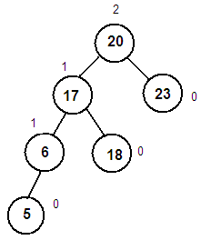
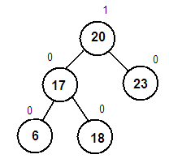
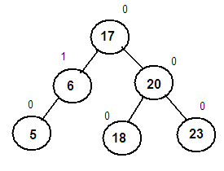
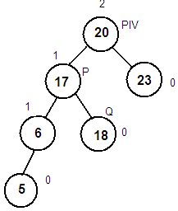
AVL ROTATIONS - RIGHT RIGHT (RR) ROTATION
RR Rotation (Pivot)
P = Pivot →Left
Q = P →Right
Root = P
P→Right = pivot
Pivot→Left = Q
End RR Rotation

Slide 24
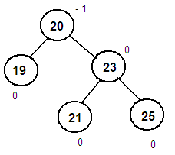
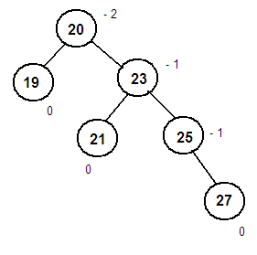
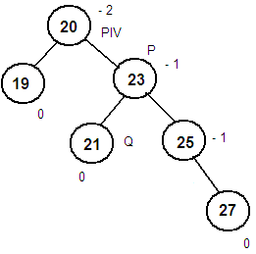
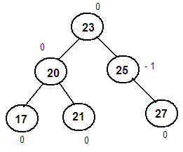
AVL ROTATIONS – LEFT LEFT (LL) ROTATION
LL Rotation (Pivot)
P = Pivot→Right
Q = P→Left
Root = P
P→Left = pivot
Pivot→Right = Q
End LL Rotation

Slide 25
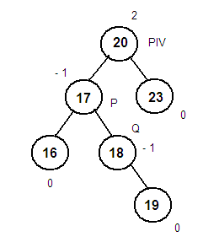
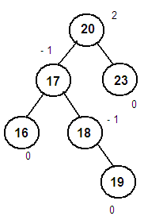
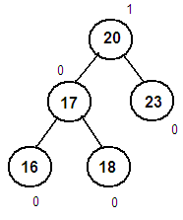
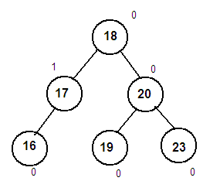
AVL ROTATIONS – LEFT RIGHT (LR) ROTATION
LR Rotation(Pivot)
P = Pivot→Left
Q = P→Right
Root = Q
P→Right=Q→Left
Q→Left = P
Pivot→Left= Q→Right
Q→Right = Pivot
End LR Rotation

Slide 26
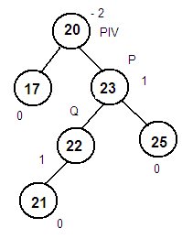
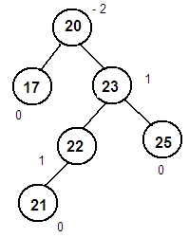
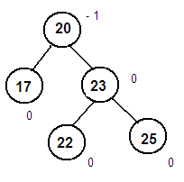
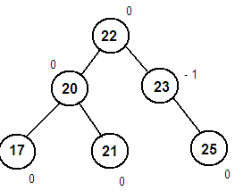
AVL ROTATIONS – RIGHT LEFT (RL) ROTATION
RL Rotation (Pivot)
P = right(pivot)
Q = left(P)
Root= Q
P→Left=Q→Right
Q→Right = P
Pivot→Right=Q→Left
Q→Left=Pivot
End RL Rotation

Slide 27
AVL TREES
Operations on an AVL Tree
The following operations are performed on AVL tree...
Search
Insertion
Deletion
The search operation in the AVL tree is similar to the SEARCH OPERATION in a Binary search tree. Search operation is performed with O(log n) time complexity.
In an AVL tree, the INSERTION OPERATION is performed with O(log n) time complexity. The insertion operation is performed as follows :
Step 1 - Insert the new element into the tree using Binary Search Tree insertion logic.
Step 2 - After insertion, check the Balance Factor of every node.
Step 3 - If the Balance Factor of every node is 0 or 1 or -1 then go for next operation.
Step 4 - If the Balance Factor of any node is other than 0 or 1 or -1 then that tree is said to be
imbalanced. In this case, perform suitable Rotation to make it balanced and then go
for next operation.
The DELETION OPERATION in AVL Tree is similar to deletion operation in BST. But after every deletion operation, we need to check with the Balance Factor condition. If the tree is balanced after deletion go for next operation otherwise perform suitable rotation to balance the tree.

Slide 28

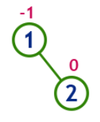
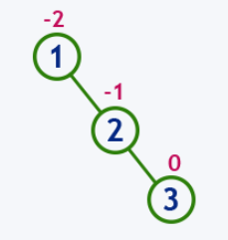
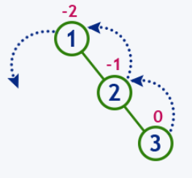
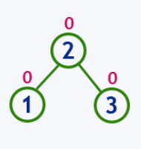
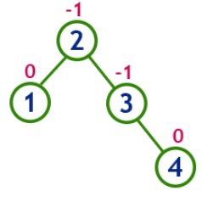
AVL TREES
Construct an AVL Tree by inserting numbers from 1 to 6.
Insert (1)
Insert (2)
Insert (3)
Insert (4)
Tree is Unbalanced
Perform LL Rotation
Tree is Balanced

Slide 29
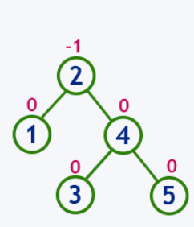
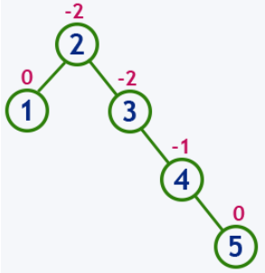
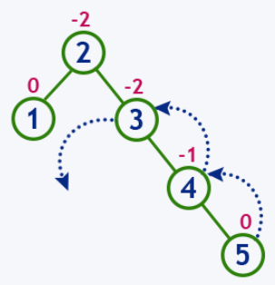
AVL TREES
Insert (5)
Tree is Balanced
Tree is Unbalanced
Perform LL Rotation

Slide 30
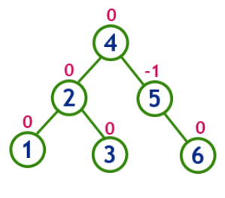
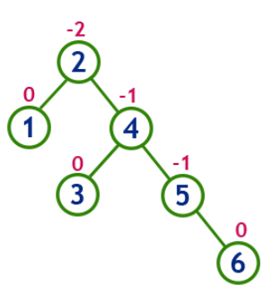
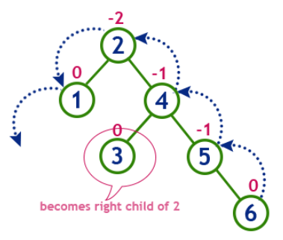
AVL TREES
Insert (6)
Tree is Balanced
Tree is Unbalanced
Perform LL Rotation

Slide 31
m-WAY SEARCH TREES (MULTIWAY SEARCH TREES)
Multiway search tree of order n is a tree in which any node may contain maximum n-1 values and can have maximum n children.
An m-way search tree is either empty or satisfies the following properties:
Each internal node has q children and q-1 elements, for 2 ≤ q ≤ m.
Nodes with p elements have exactly p + 1 children
Suppose a node has p elements.
Let k₁, k₂, …, k_{p} be the keys of these elements.
then k₁ < k₂ < … < k_{p}.
Let c₀, c₁, …, c_{p} be the p+1 children of the node.
The elements in the subtree with root c₀ have keys smaller than k₁.
The elements in the subtree rooted at c_{i} have keys larger than k_{i} and smaller than k_{i+1}, 1 ≤ i < p.
The elements in the subtree rooted at c_{p} have keys larger than k_{p}.
Notes:
There is a special type of search tree called m-way Search tree in which a node contains more than one value (key) and more than two children.

Slide 32
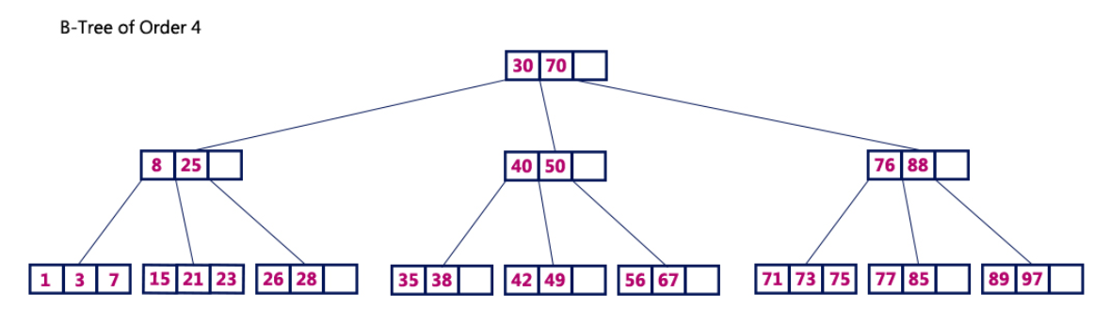
B TREES
Notes:
For example, B-Tree of Order 4 contains a maximum of 3 key values in a node and maximum of 4 children for a node.

Slide 33
B TREES
In search trees like binary search tree, AVL Tree, Red-Black tree, etc., every node contains only one value (key) and a maximum of two children.
B-Tree was developed in the year 1972 by Bayer and McCreight with the name Height Balanced m-way Search Tree. Later it was named as B-Tree.
B-Tree is a self-balanced search tree in which every node contains multiple keys and has more than two children.
A B-Tree of order m is an m-way search tree.
If the B-tree is not empty, the corresponding extended tree should satisfy the following properties.
Notes:
B-tree is a self-balancing tree data structure that maintains sorted data and allows searches, sequential access, insertions, and deletions in logarithmic time.
The B-tree generalizes the binary search tree, allowing for nodes with more than two children.^{[2]} Unlike other self-balancing binary search trees, the B-tree is well suited for storage systems that read and write relatively large blocks of data, such as disks. It is commonly used in databases and file systems.
B-trees were invented by Rudolf Bayer and Edward M.McCreight while working at Boeing Research Labs, for the purpose of efficiently managing index pages for large random access files. The basic assumption was that indexes would be so voluminous that only small chunks of the tree could fit in main memory. Bayer and McCreight's paper, Organization and maintenance of large ordered indices,^{[1]} was first circulated in July 1970 and later published in Acta Informatica.^{[3]}
According to Knuth's definition, a B-tree of order m is a tree which satisfies the following properties:
Every node has at most m children.
Every non-leaf node (except root) has at least ⌈m/2⌉ child nodes.
The root has at least two children if it is not a leaf node.
A non-leaf node with k children contains k − 1 keys.
All leaves appear in the same level and carry no information.

Slide 34
B TREES
B-Tree of Order m has the following properties...
All nodes except root must have at least [m/2]-1 keys and maximum of m-1 keys.
All leaf nodes must be at same level.
B-Tree can exist with only one node. i.e., the Root node containing no children.
All non leaf nodes except root (i.e. all internal nodes) must have at least m/2 children and maximum m children.
If the root node is a non leaf node, then it must have atleast 2 children.
A non leaf node with n-1 keys must have n number of children.
All the key values in a node must be in Ascending Order.
Notes:
In computer science, a 2–3 tree is a tree data structure, where every node with children (internal node) has either two children (2-node) and one data element or three children (3-nodes) and two data elements.
A 2-3 tree is a B-tree of order 3.^{[1]}
Nodes on the outside of the tree (leaf nodes) have no children and one or two data elements.^{[2][3]}
2−3 trees were invented by John Hopcroft in 1970.^{[4]}

Slide 35
B TREES
Why B-Trees?
Reduces the number of reads made on the disk.
B Trees can be easily optimized to adjust its size (that is
the number of child nodes) according to the disk size.
It is a specially designed technique for handling a bulky
amount of data.
It is a useful for databases and file systems.
Multi-level index can be designed by using B Tree for
storing the sorted data in a self-balancing fashion.

Slide 36
Operations on a B-Tree
The following operations are performed on a B-Tree :
Search(Root,K)
Insertion(Root,X)
Deletion(Root,X)

Slide 37
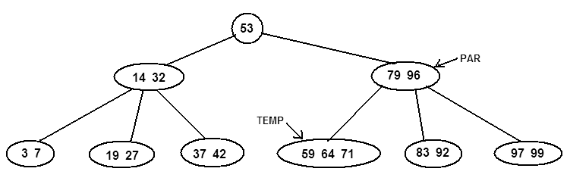
B TREES – SEARCH
SEARCH( 53, 64)
SEARCH( ROOT, K )
Temp = ROOT, i = 1, Pos = 0
while i ≤ COUNT(Temp) and Temp → Child[i] ≠ NULL
if K = = Temp[i] → Data
Pos = i
return Temp
else
if k < Temp[i] → Data
SEARCH(Temp → Child[i], K)
else
if i = = COUNT(Temp)
Par = Temp
Temp = Temp → Child[i+1]
else
i = i + 1
end if
end if
end if
end while
while i ≤ COUNT(Temp)
if k = = Temp[i] → Data
Pos = i
return Temp
else
i=i+1
end if
end while
end SEARCH
2
1

Slide 38
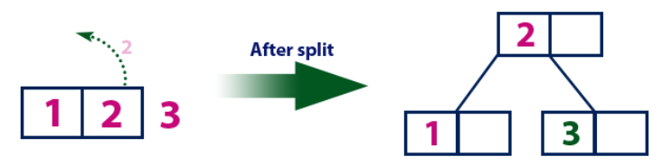






B TREES - INSERTION
Insert elements from 1 to 7
Notes:
Every node has at most m children.
Every non-leaf node (except root) has at least ⌈m/2⌉ child nodes.
The root has at least two children if it is not a leaf node.
A non-leaf node with k children contains k − 1 keys.
All leaves appear in the same level and carry no information.

Slide 39

B TREES - INSERTION

Slide 40




B TREES - INSERTION
A
A | G
A | F | G
A | B | F | G
A | B | F | G | K

Slide 41


B TREES - INSERTION

Slide 42

B TREES - INSERTION

Slide 43


B TREES - INSERTION

Slide 44
B TREES - INSERTION

Slide 45


B TREES - INSERTION

Slide 46


B TREES - INSERTION

Slide 47

B TREES - INSERTION

Slide 48
B TREES - INSERTION
Insert Operation:
The following algorithm applies:
Run the search operation and find the appropriate place of insertion.
Insert the new key at the proper location, but if the node has a maximum number of keys already:
The node, along with a newly inserted key, will split from the middle element.
The middle element will become the parent for the other two child nodes.
The nodes must re-arrange keys in ascending order.
Notes:
Since B Tree is a self-balancing tree, you cannot force insert a key into just any node.

Slide 49
B TREES - DELETION
Case-II : If key k is in node x and x is an internal node, there are three cases:
Case-II-A :
If the child y that precedes k in node x has at least t keys (more than the minimum), then find the predecessor key k' in the subtree rooted at y. Recursively delete k' and replace k with k' in x
Case-II-B:
Symmetrically, if the child z that follows k in node x has at least t keys, find the successor k' and delete and replace as before. Note that finding k' and deleting it can be performed in a single downward pass.
Case-II-C:
Otherwise, if both y and z have only t−1 (minimum number) keys, merge k and all of z into y, so that both k and the pointer to z are removed from x. y now contains 2t − 1 keys, and subsequently k is deleted.

Slide 50
B TREES - DELETION
Case-III : If key k is not present in an internal node x, determine the root of the appropriate subtree that must contain k. If the root has only t − 1 keys, execute either of the following two cases to ensure that we descend to a node containing at least t keys. Finally, recurse to the appropriate child of x.
Case-III -A :
If the root has only t−1 keys but has a sibling with t keys, give the root an extra key by moving a key from x to the root, moving a key from the roots immediate left or right sibling up into x, and moving the appropriate child from the sibling to x.
Case-III-B:
If the root and all of its siblings have t−1 keys, merge the root with one sibling. This involves moving a key down from x into the new merged node to become the median key for that node.

Slide 51


B TREES - DELETION
Case I : Key K is in node X and X is a leaf, simply delete K from X.
Delete (6)
Notes:
Case I : If the key is already in a leaf node, and removing it doesn’t cause that leaf node to have too few keys,
then simply remove the key to be deleted. key k is in node x and x is a leaf, simply delete k from x.

Slide 52


B TREES - DELETION
Case II A,B : Symmetrically, if the child z that follows k in node x has at least t keys, find the successor k' and delete and replace as before. Note that finding k' and deleting it can be performed in a single downward pass.
Delete (13)
Notes:
Case I : If the key is already in a leaf node, and removing it doesn’t cause that leaf node to have too few keys,
then simply remove the key to be deleted. key k is in node x and x is a leaf, simply delete k from x.

Slide 53


B TREES - DELETION
Case II C : Otherwise, if both y and z have only t−1 (minimum number) keys, merge k and all of z into y, so that both k and the pointer to z are removed from x. y now contains 2t − 1 keys, and subsequently k is deleted.
Delete (7)

Slide 54


B TREES - DELETION
Case-III-A: If the root has only t−1 keys but has a sibling with t keys, give the root an extra key by moving a key from x to the root, moving a key from the roots immediate left or right sibling up into x, and moving the appropriate child from the sibling to x.
Delete (2)

Slide 55



B TREES - DELETION
Case-III-B: If the root and all of its siblings have t−1 keys, merge the root with one sibling. This involves moving a key down from x into the new merged node to become the median key for that node.
Delete (11)

Slide 56


B TREES - DELETION
Delete (E)

Slide 57

B TREES - DELETION
Delete (F)

Slide 58


B TREES - DELETION

Slide 59



B TREES - DELETION
Delete (M)
Notes:
Delete'M'from'non"leaf'node’
Note:'immediate'predecessor'in'non"leaf' Is'always'in'a'leaf.'

Slide 60
B TREES - DELETION
If the target key is in the leaf node
Target is in the leaf node, more than min keys.
Deleting this will not violate the property of B Tree
Target is in leaf node, it has min key nodes
Deleting this will violate the property of B Tree
Target node can borrow key from immediate left node, or immediate right node (sibling)
The sibling will say yes if it has more than minimum number of keys
The key will be borrowed from the parent node, the max value will be transferred to a parent, the max value of the parent node will be transferred to the target node, and remove the target value
Target is in the leaf node, but no siblings have more than min number of keys
Search for key
Merge with siblings and the minimum of parent nodes
Total keys will be now more than min
The target key will be replaced with the minimum of a parent node

Slide 61
B TREES - DELETION
If the target key is in an internal node
Either choose, in- order predecessor or in-order successor
In case the of in-order predecessor, the maximum key from its left subtree will be selected
In case of in-order successor, the minimum key from its right subtree will be selected
If the target key's in-order predecessor has more than the min keys, only then it can replace the target key with the max of the in-order predecessor
If the target key's in-order predecessor does not have more than min keys, look for in-order successor's minimum key.
If the target key's in-order predecessor and successor both have less than min keys, then merge the predecessor and successor.

Slide 62
B TREES - DELETION
If the target key is in a root node
Replace with the maximum element of the in-order predecessor subtree
If, after deletion, the target has less than min keys, then the target node will borrow max value from its sibling via sibling's parent.
The max value of the parent will be taken by a target, but with the nodes of the max value of the sibling.

Slide 63
B TREES - DELETION
if x is leaf, then
delete object with key ‘key’ from x
else
if x does not contain the object with key ‘key’, then
locate the child x->child[i] whose key range is holding
‘key’ y := x->child[i]
if y has m/2 elements, then
if the sibling node z immediate to the left or right of y,
has at least one more object than m/2, add one more
object by moving x->key[i] from x to y, and move
that last or first object from z to x.
if y is non-leaf node, then last or first
child pointer in z is also moved to y
else
any immediate sibling of y has m/2 elements, merge y
with immediate sibling
end if
BTreeDelete(y, key)
else
if y that precedes ‘key’ in x, has at-least m/2 + 1 objects, then
find predecessor k of ‘key’, in the sub-tree rooted by y. then recursively delete k
from the sub-tree and replace key with k in x
else if ys has m/2 elements, then
check the child z, which is immediately follows ‘key’ in x
if z has at least m/2+1 elements, then
find successor k of ‘key’, in the sub-tree rooted by z. recursively delete k
from sub-tree, and replace key with k in x
else
both y and z has m/2 elements, then merge then into one node, and push ‘key’
down to the new node as well. Recursively delete ‘key’ from this new node
end if
end if

Slide 64


B TREES - DELETION
Deletion Case 1: Delete(53, 64)
Notes:
Case 1: The node from which the value is deleted has minimum n/2 values even after deletion.
Let us consider the following B-Tree of order 5.
A value 64 is to be deleted. Even after the deletion of the value 64, the node has minimum n/2 values (i.e., 2 values).
Hence the rules of the B-Tree are not violated.

Slide 65

B TREES - DELETION
Deletion Case 2: Delete(53, 92)
Notes:
Case 2: In the second case, after the deletion the node has less than minimum n/2 values.
Let us say we delete 92 from the tree. After 92 is deleted, the node has only one value 83.
But a node adjacent to it consist 3 values (i.e., there are extra values in the adjacent node).
Then the last value in that node 71 is pushed to its parent and the first value in the parent namely 79 is pushed into the node which has values less than minimum limit.
Now the node has obtained the minimum required values.

Slide 66


B TREES - DELETION
Deletion Case 3: Delete(53, 42)
Notes:
Case 3: In the previous case, there was an adjacent node with extra elements and hence the adjustment was made easily.
But if all the nodes have exactly the minimum required, and if now a value is deleted from a node in this, then no value can be borrowed from any of the adjacent nodes.
Hence as before a value from the parent is pushed into the node (in this case 32 is pushed down).
Then the nodes are merged together.
But we see that the parent node has insufficient number of values.
Hence same process of merging takes place recursively till the entire tree is adjusted.

